Slide 1

Healthcare Data Analytics – Using Python, Tableau, and DataRobot
Jay Wang
January 25, 2019

Slide 2
Hospital Readmission
Definition
A patient is readmitted to hospital within 30 days of discharge
Impact
Financial burden
Stress on the patient
ESRD patients have high risk of hospital admission and readmissions
Both dialysis facilities and hospitals are penalized for higher readmissions
Standardized Readmission Ratio (SRR) is risk-adjusted (age, gender, comorbidity)
SRR = Actual Readmissions / Expected Readmissions
< 1 indicates better than expected
=1 indicates as expected
>1 indicates worse than expected

Slide 3
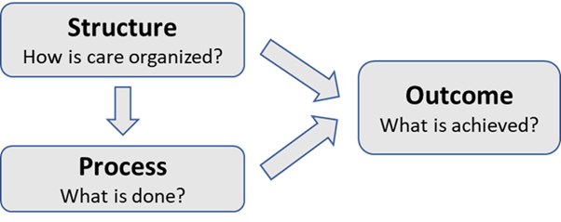
Donabedian Healthcare Quality Model
This model is used to select quality measures and their data sources and data elements

Slide 4
Factors Associated with Dialysis Facility SRR
Data Preparation using Python
https://www.kaggle.com/wcj365/rmudsc (Login required)
Data Visualization using Tableau
https://public.tableau.com/profile/jaywang
Predictive Analytics using RapidMiner
https://automodel.rapidminer.com/ (login required)
Using Data Visualization and Machine Learning to Gain Insights from Data

